Slide 1
Group Name
Charlotte Betts, Helga Hadalin, , Ben Rochmankowski, Henrique Sato
RAL Visitor Centre
07.07.23

Slide 2
Personal Introduction & How Has This Work Experience Benefited You?
Show pictures (these don’t have to include you) / images / etc
Not much text
Tell us:
Your name
Adventures / hobbies / pets / achievements / likes / ambitions
How has this experience benefited you?
If this experience has been useful, we would be happy to hear it!
If you now know that you hate python for example, that is a big win! We won’t feel bad, this is about you not us.
Consider things like teamwork, sharing perspectives, approaching problem solving, etc
Feedback also welcome; e.g. “more tours”, “less git”, “more biscuits”…

Slide 3
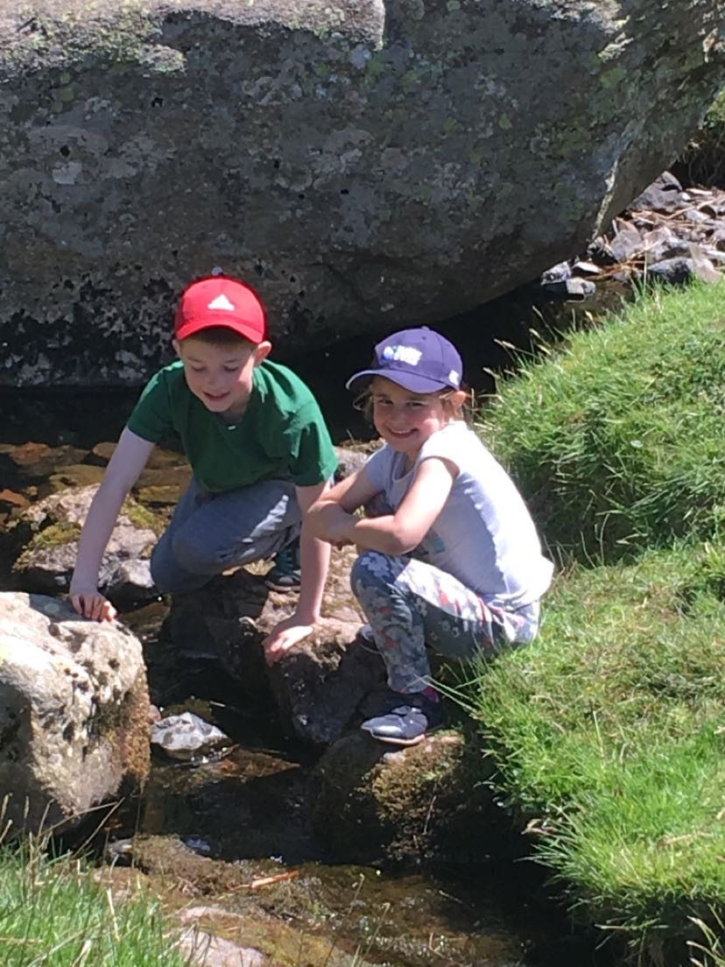
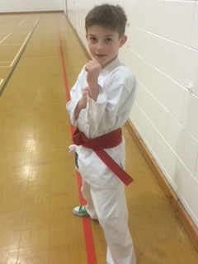
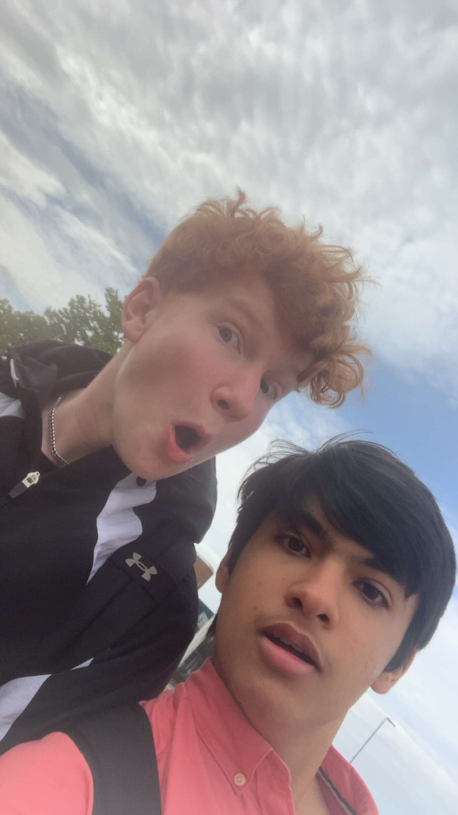
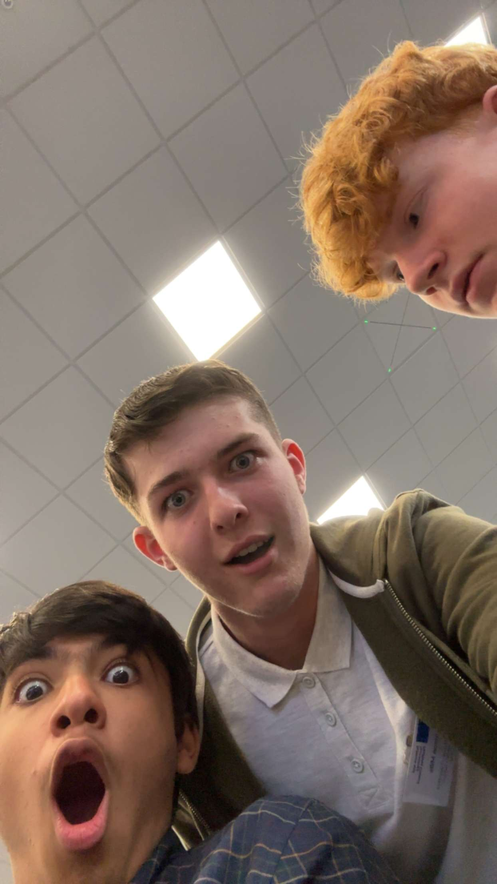
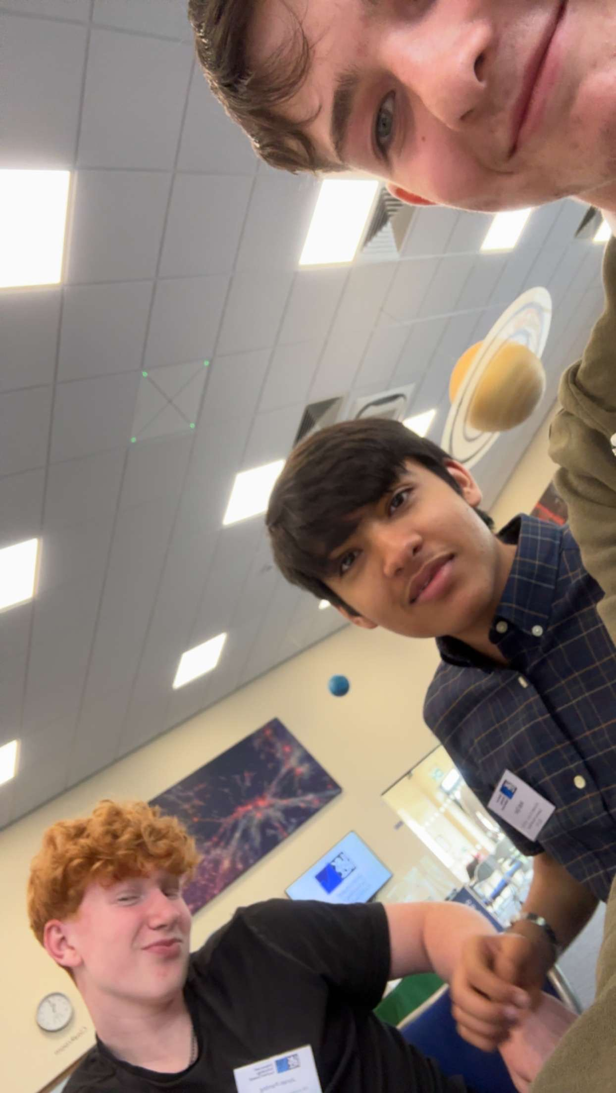
Harrison Mills – About me
One of my favourite hobbies is Karate, and I’ve always enjoyed going out and doing lots of walking from a young age
I enjoy working at a bar (no photos unfortunately)
I enjoy messing around with my friends when I’m not working hard

Slide 4
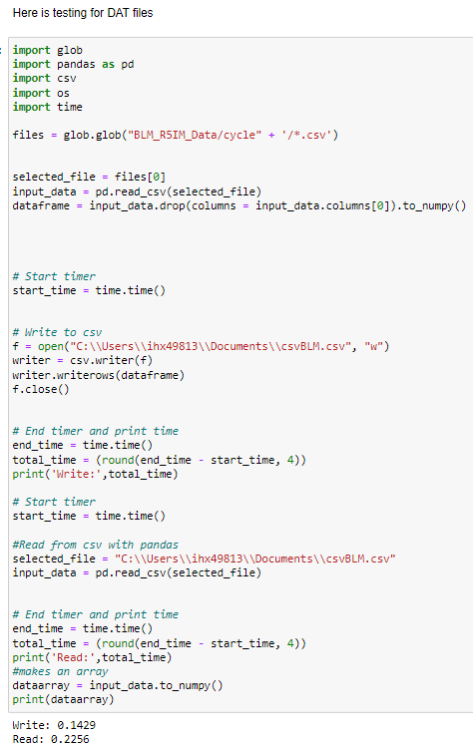
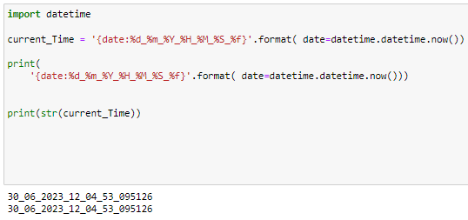
Stage 1 Projects: Group 1E: File Handling
I did mostly testing
I did testing for data files (.DAT)
I did testing for pickle files (.pkl) which I couldn’t get to work (regrettably)
I wrote code to add the exact date and time of files upon creation

Slide 5
Stage 2 Projects: Waterfall GUI
From the beginning, I worked on collaborations
Then I moved on to writing functions for the GUI

Slide 6
Acknowledgments
We are privileged to do a job that we love, and one that serves so many. In order to do big science we require vast teams and incredible people who support our work. We must always acknowledge those who contribute to our success.
Our cleaner Pamela sanitises every desk in the building, vacuums our biscuit crumbs, mops the floors, disposes of our cups and napkins, carries our refuse to the industrial bins, ensures we have clean toilets, and often moves furniture, every day before we arrive.
Our reception team have had to phone a grumpy physicist on every occasion that you forgot your badges, and often I’ve missed their calls so they’ve sorted you out anyway. That’s a lot of unnecessary hassle for them.
Our public engagement (PE) team have read ~ 700 wx applications, sifted and sorted your applications, so that we could select you individually. All other wx students have a desk wherever their supervisor can find space. The PE team have not only granted us their space for 2 weeks, but the use of their laptops. We have exceptionally been granted use of their personal kitchen.
Please delete the above message and keep it simple:
Public Engagement Team
Etc

Slide 7
GUI Demo
5 minutes max, show live data, demo mode, change some settings and show features

Slide 8
Thank you
Questions?

